Slide 1
Wireless Behind-the-Ear EEG
Lucas Pinto

Slide 2
Epilepsy is characterized by recurrent seizures and hyper-synchronous brain activity
Diagnosing epilepsy usually requires :
Paroxysmal EEG recordings of hyper-synchronous uninterruptable neural firing
History of recurrent seizures

Slide 3
Epilepsy affects 50 million people worldwide
People with epilepsy respond positively to treatment 70% of the time
~80% of affected individuals live in low/middle income countries
~3/4 of those individuals don’t receive the treatment they need

Slide 4
Infrequent seizures are a longstanding challenge in epilepsy diagnosis
Many patients have infrequent seizures (1/month) making it difficult to diagnose episodes as epileptiform activity
Majority of EEG recordings capture interictal activity. Even then capturing an interictal epileptiform discharge is typically not enough for diagnosis
Bottom line: we have to capture the seizure

Slide 5
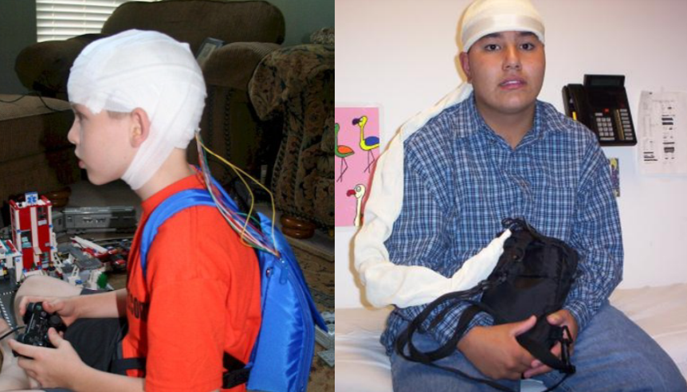
Different types of EEG systems already exist and are being used clinically
Ambulatory systems
Brain Computer Interfaces
Transcranial Direct Current Stimulators
Wireless EEGs

Slide 6
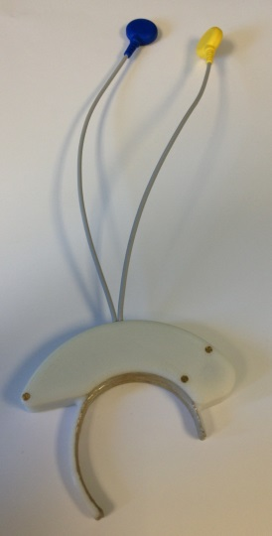
We propose a wireless behind-the-ear EEG that connects to an iPhone/iTouch
MGH server
Bluetooth
Wi-Fi

Slide 7
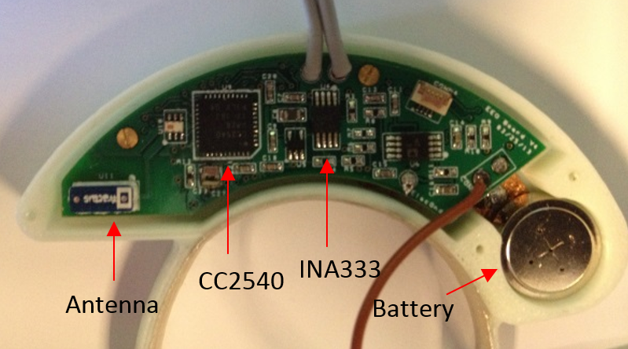
Brain activity is recorded, amplified, and converted to µC

Slide 8
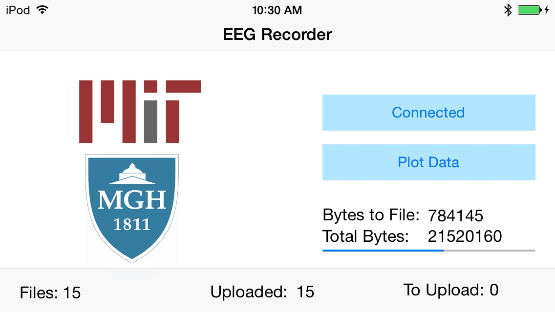
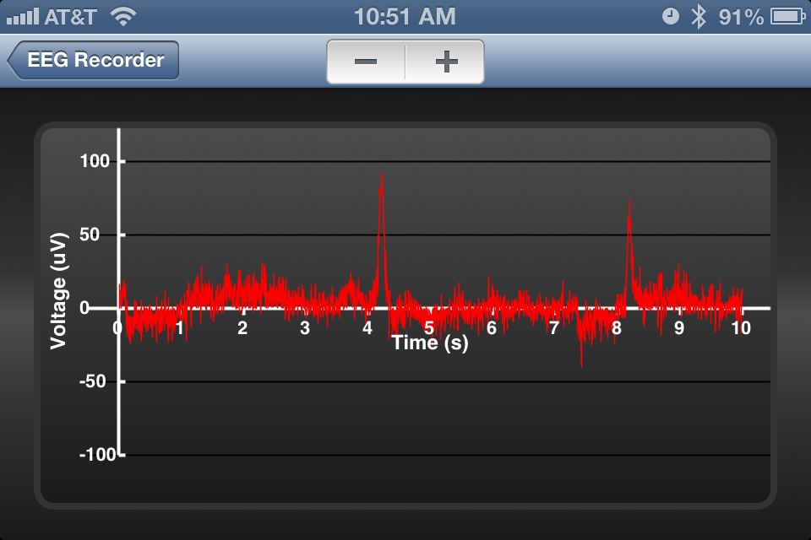
The app converts µC to µV, monitors BLE connection and plots data in real-time

Slide 9
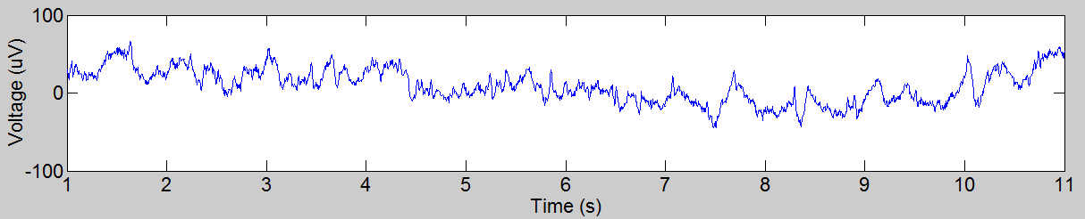
The app connects to the MGH server via Wi-Fi periodically to upload raw EEG data

Slide 10
Future Directions
More data from multiple patients
Physician interface and real-time streaming
Hardware enhancement (more electrodes, cosmetic appeal)
More production, foreign distribution

Slide 11
References
Neuroelectrics.com
Emotiv.com
Imec, Holst Centre and Panasonic Present Wireless Low-power Active-Electrode
EEG Headset (Apr. 10, 2012) [Online], http://www2.imec.be/be_en/press/imec-news/imeceeg2012.html
Jiawei Xu; Yazicioglu, R.F.; Harpe, P.; Makinwa, K. A A; Van Hoof, C.,
"A 160μW 8-channel active electrode system for EEG monitoring," Solid-State Circuits Conference
Digest of Technical Papers (ISSCC), 2011 IEEE International , vol., no., pp.300,302, 20- 24 Feb. 2011.
S. R. e. a. Haut, “Seizure occurrence: Precipitants and prediction,” Neurology, pp. 1905–1910, Nov. 2007.
When is drug treatment not necessary in epilepsy? Factors that should influence the decision to prescribe
Richard W Newton, MD, J R Soc Med. 2004 Jan; 97(1): 15–19.

Slide 12


Acknowledgements
Susanne Churchill
HST Faculty
Sydney Cash
Junior Moura
Bruno Valle
Cash lab
Patients at MGH

